Slide 1

TESTING
@Adamstephensen | Solution Architect @ SSW
Notes:
I’ve just finished my first application using Visual Studio 2015, MVC 6 and AngularJs
I’m so excited to be be building enterprise web apps, leveraging all the front end best practices developed by the javascript community, using my C#, MVC and WebAPI skills for the backend and doing it all with the productivity of visual studio, .

Slide 2

DO ALL
THE
TESTING

Slide 3
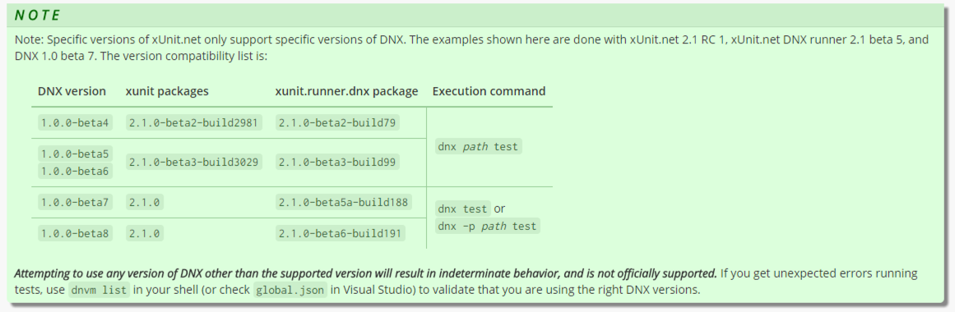
Warning: You have to get your versions right

Slide 4
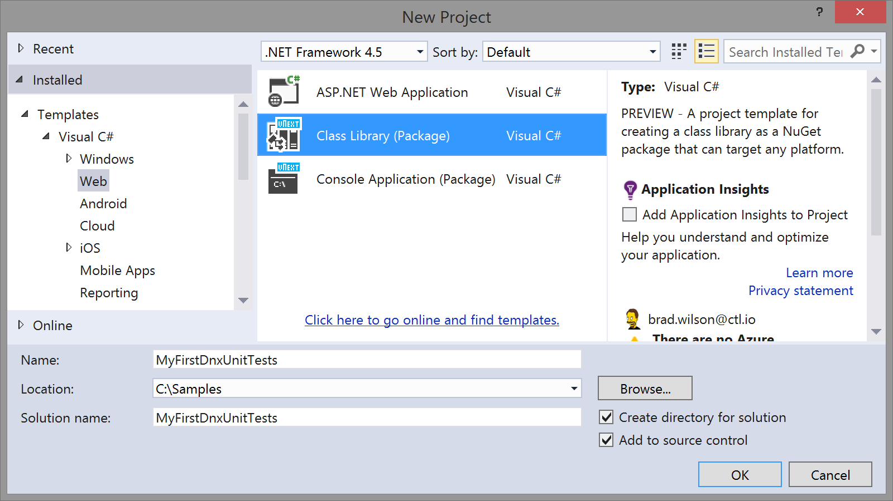
Create a class library package

Slide 5
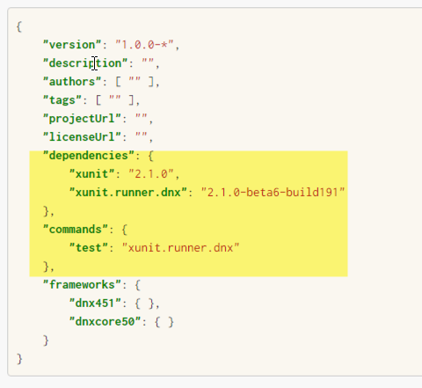
Add a reference to xunit in project.json

Slide 6
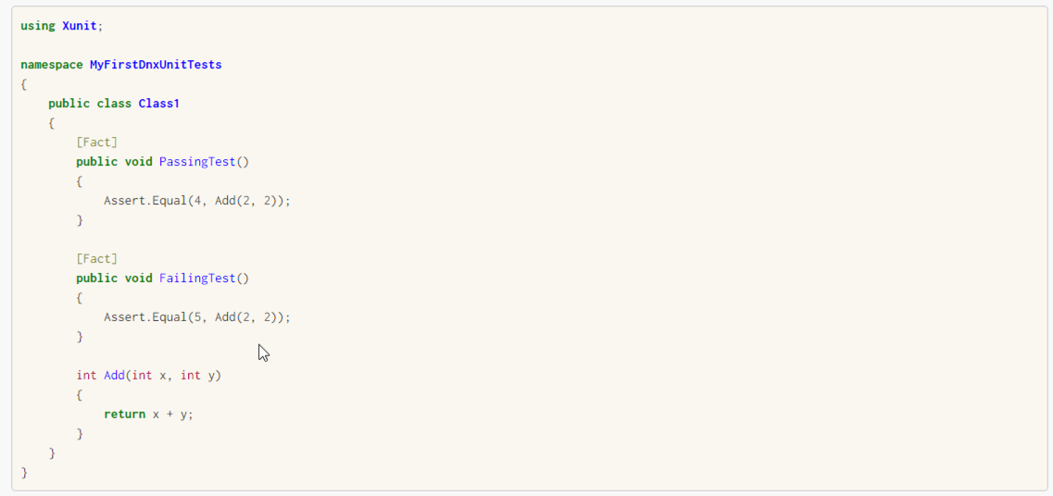
Write your first test

Slide 7
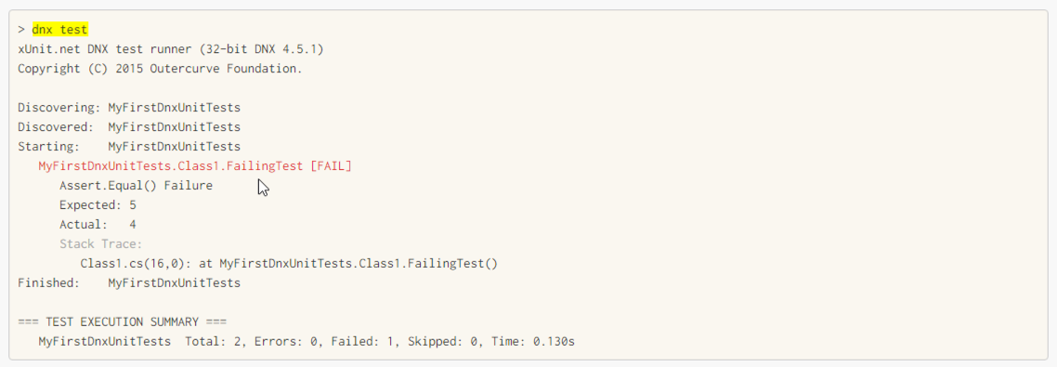
Run it from the command line

Slide 8
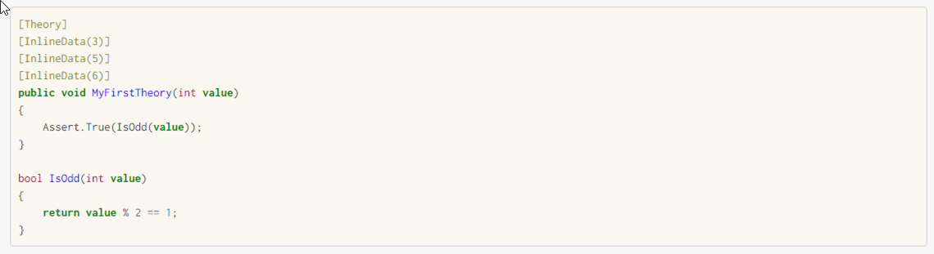
Write your first theory
Notes:
Facts are tests which are always true. They test invariant conditions.
Theories are tests which are only true for a particular set of data.

Slide 9
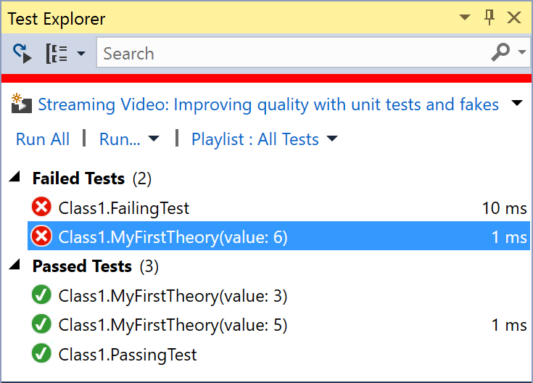
Run Tests from Visual Studio (Test | Windows | Test Explorer)

Slide 10

Summary Thank you: You helped me know what's awesome!
Add reference to Xunit
Write our first Xunit test
Use Theories
Run Tests from the Command line
Run Tests from Visual Studio
Summary

Slide 11
Thank you! info@ssw.com.au www.ssw.com.au Sydney | Melbourne | Brisbane | Adelaide
Tweet your favourite feature
@AdamStephensen #NetUG
Notes:
Thanks for listenting, and please drop me a tweet with your feedback

